Slide 1
Telford Land Deal Annual Report (21/22) Marches LEP Board 29 November 2022

Slide 2
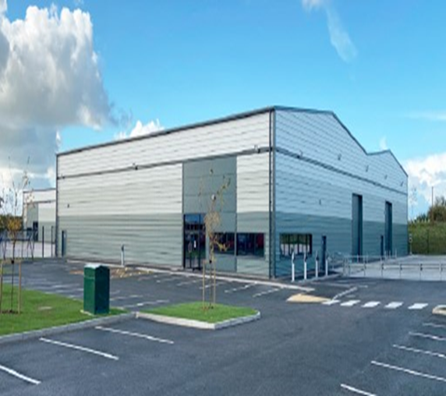
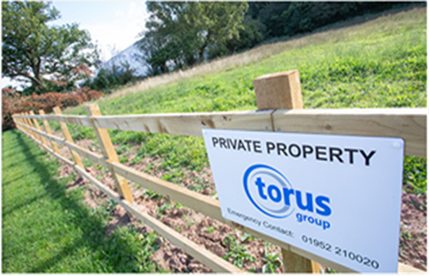
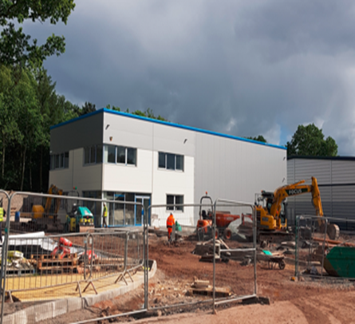
Telford Land Deal
Recommendation
That Board notes the outcomes achieved during the 2021/2022 financial year and overall since the Land Deal Board members.

Slide 3
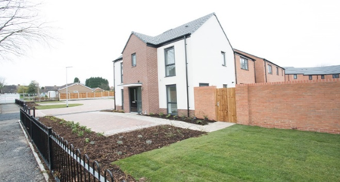
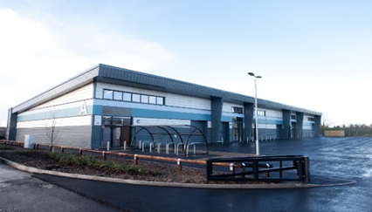
Telford Land Deal - Overview
Objectives:
Accelerate delivery of sites to market including brownfield and stalled sites
Delivery of outputs over a 10 year programme: 2800 new homes, 8500 jobs and 300,000 sq.m of commercial floor space
Generate capital receipts site by site over and above baseline (2015) values.​ ​

Slide 4
Funding Model
Rolling 3 year Investment and Disposal Plan – setting out investment into sites; site sales and outputs
First call on receipts:
– repayment 2015 values
– agreed partner costs
Any remainder = profit share
Allocation of profit share :
- Profit share Homes England– 15%
- Profit Share TWC – 85%
Within 85% TWC profit share – first £2m earmarked to ‘constrained sites’ and 15% to the Marches LEP

Slide 5
Headlines – The Land Deal
2015/16-2021/22
Delivered the sale of a total of 29 commercial sites and 23 sites for residential development
Gross sales income of £41.9 million.
EFS of 143,988sqm (1,549,873sqft)
Delivery of 1926 new jobs.
1284 new homes
2021/22
Gross sale income of £1.6 million
EFS of 13,109sqm (141,104sqft)
Delivery of 200 new jobs
343 new homes
2022/23 (forecast)
Gross sale income of c.£21 million
EFS of 59,192sqm (637,137sqft)
Delivery of 442 jobs
299 new homes (Stats reported to DLUHC - Appendix A)

Slide 6
Benefits to Telford and Wrekin Offer
React quickly to the market
Capitalise on investment demand
De-risk sites for employment and residential development
Provide bespoke buildings for end users
Invest in infrastructure to enable delivery
Job creation and safeguarding of jobs
Provides a unique service to investors:
Land Deal
Growth Fund
Enterprise Telford Pledge

Slide 7
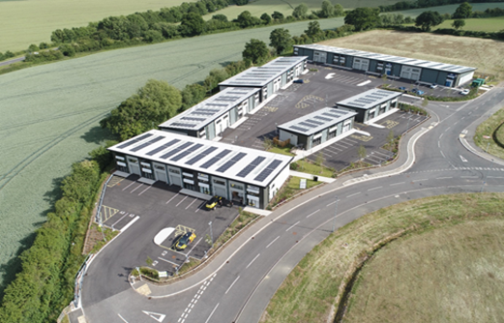
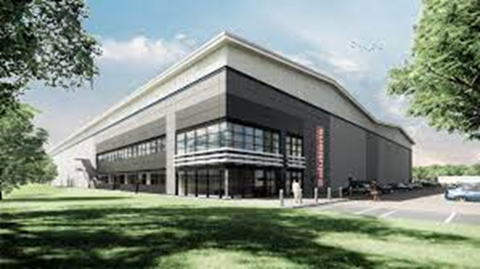
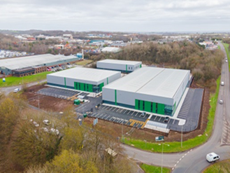
Achievements
Ni.Park Newport
Delivery of 24 Phase 1 units completed October 2021
Phase 2 - 3 units 2,787sqm (30,000sqft), due to start late 2022
Solar panels and EV charging
Phase 1 and 2 Funded through profit share generated from Land Deal and the Council’s Growth Fund
Hortonwood Plot 11B
Sale completed Sept 2021
Started on site Sept 2021, completed July 2022
Delivered 11,482sqm (123,592sqft) production and warehouse unit
New Head Quarters Building for Portion Solutions Ltd
Halesfield 18
Sold to Redsun Projects Ltd
3 industrial units totalling 7153sqm (77,000sqft)
Energy Performance Rating A
Started onsite Feb 2021, completed March 2022
Smartwater, Load Lock & Sirane

Slide 8
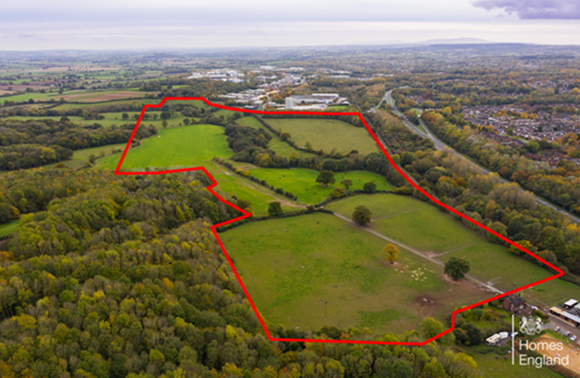
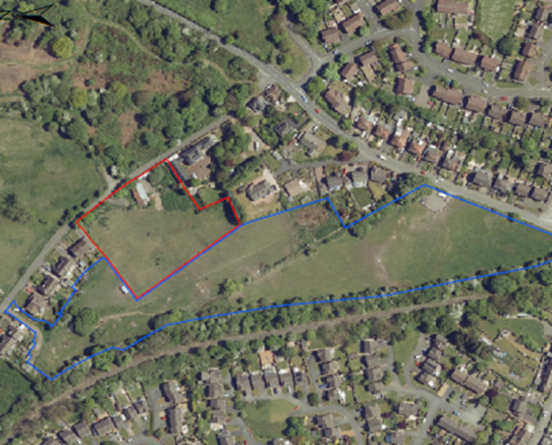
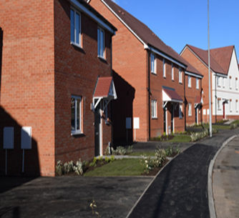
Achievements
Land at The Hem, Nedge
Planning consent secured for 350 new homes.
Contracts exchanged subject to planning.
25 % affordable homes
Start on site expected April 2023
Pool Hill Road, Site D
Site acquired by Central and County for 36 new homes
Joint disposal between the Council (21) and Homes England (11)
Start on site expected early 2023
Majestic Way
Sold to Living Space Housing Ltd for 39 new homes
100% affordable homes
Work started Dec 2020, development completed April 2022

Slide 9
Land Deal Investment to date
£21.9M gross cumulative investment 7 years to 31 March 2022
£41.9M gross land receipts in the same period
£8.2M cumulative profit share achieved by the partners:
Homes England - £1.23M
TWC - £6.22M
Net LEP - £0.75M *
*15% of TWC after £2M for constrained sites

Slide 10
Investment of TWC’s Profit Share
Address | Investment | Purpose
Plot 2 Hortonwood West | £1.0m | Viability gap funding to support delivery of 15 small business starter units
Identified ‘constrained sites’ within the Land Deal | £1.0m | Remediation and stabilisation works across named sites identified for investment in the overarching Land Deal in lieu of HE investment
Phase 1 NiPark | £0.5m | Viability gap funding to support delivery of 24 units for agri –tech/enterprise use
Phase 2 NiPark | £1.4m | Viability gap funding to support delivery of 3 x 10,000sq.ft units.
Plot 12 Hortonwood West | £3.1m | Viability gap funding to support delivery of 24 starter/business units
Oakengates & Station Quarter | Up to £14m | viability gap fund the delivery of the infrastructure, enabling and commercial elements of the proposals

Slide 11
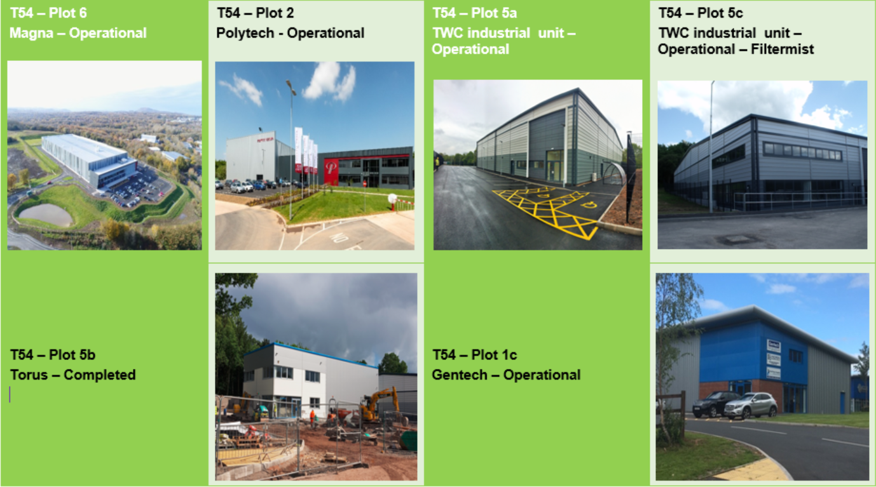
Enabled Commercial Developments

Slide 12
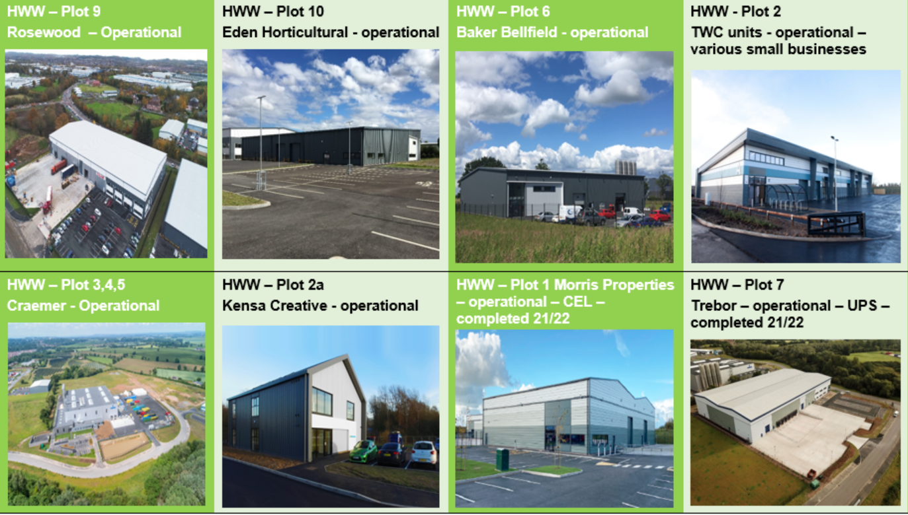
Enabled Commercial Developments

Slide 13
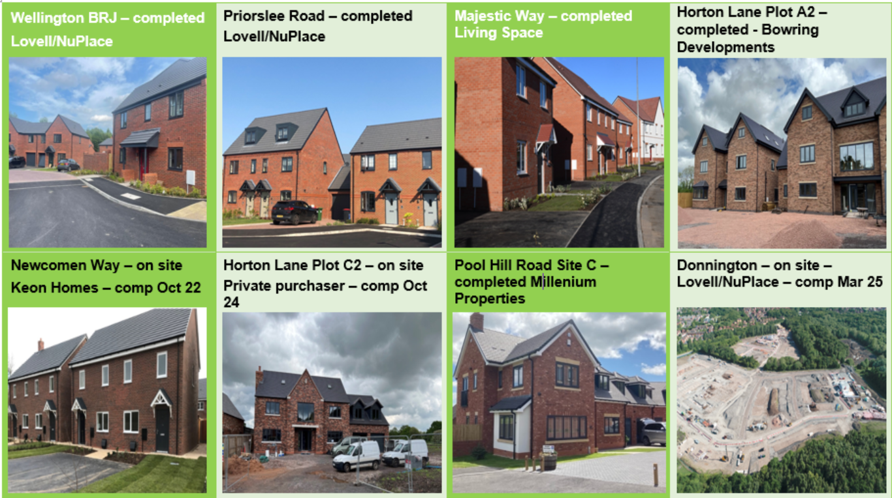
Enabled Residential Developments

