Slide 1
Telford & Wrekin Council
Project Update
November 2022

Slide 2
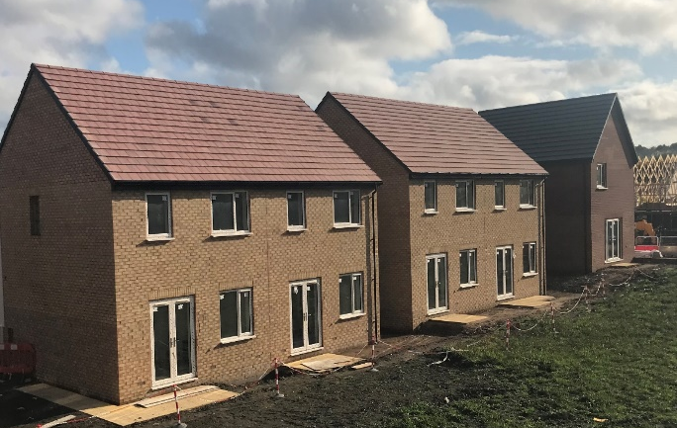
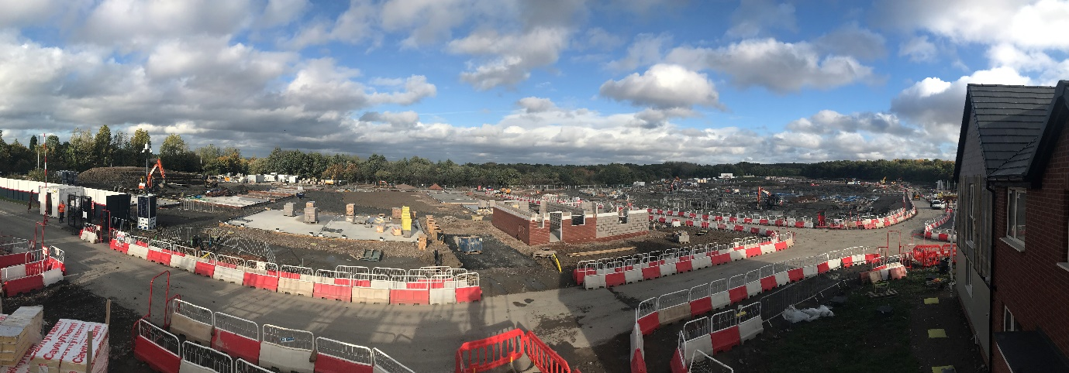
Stronger Communities: Granville
Development of 329 homes including affordable, private rent, market sale and supported and specialist accommodation
WHG Affordable:
  First handovers scheduled for December 2022.
Nuplace PRS
  52 plots piled.
  Anticipated transfer ‘Golden Brick’ March 2023.
Lovell - Open Market
  Show Homes – launched 7th September.
  2 plots reserved as at 29th September.

Slide 3
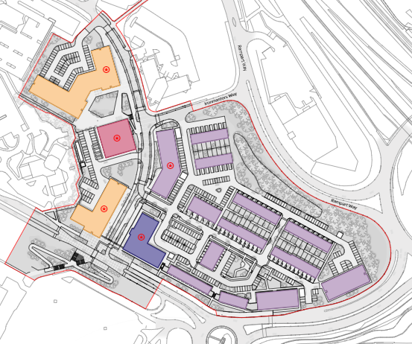
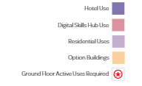
Stronger Communities: Station Quarter

Slide 4
Stronger Communities: Station Quarter – Scheme Development
Through detailed design and discussions with the affordable housing deliver partner L&GAH the following housing mix has been finalised for Phase 1 totalling 190 dwellings (LEP requirement of 142 dwellings);
  117 Nuplace dwellings for private rent
  73 Legal & General Affordable Homes (L&GAH)
  High density dwellings providing scale and mass
All homes NDSS complaint with 23% M4(2) and M4(3)
Sustainable, achieving 31% betterment in terms of carbon emissions – meeting new Part L Regs.
  L&GAH mixture of affordable rent and shared ownership – 38% of Phase 1 dwellings.

Slide 5
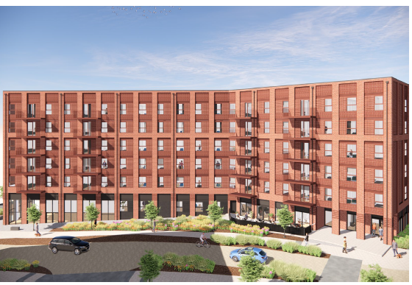
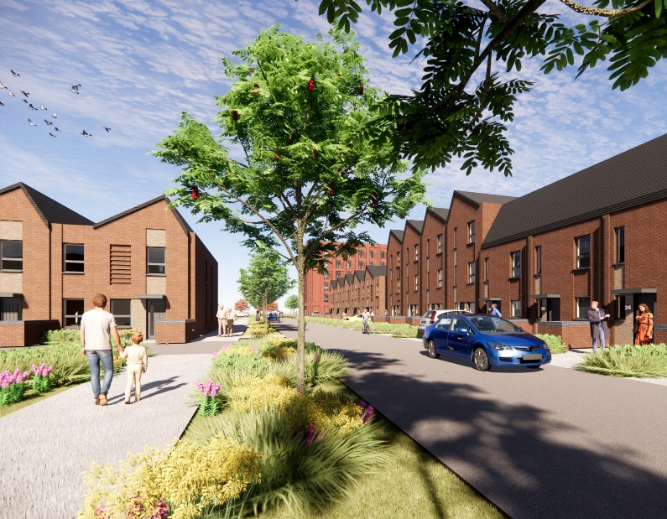
Stronger Communities -Station Quarter - Programme
      RIBA Stage 3 design: Complete.
      RIBA Stage 4 design: September 2022 to December 2022
      Planning application: October 2022 for planning committee Feb 2022
      Enabling Works: November 2022 – April 2023
      Main Works: April 2023 – Summer 2025

Slide 6
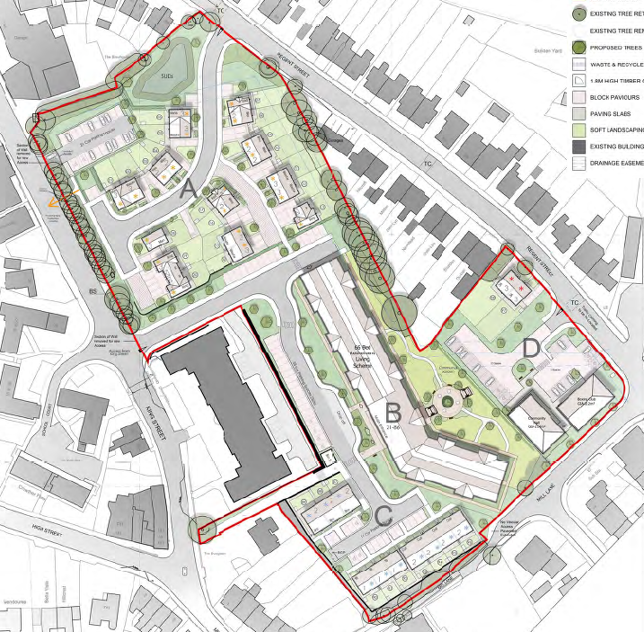
Stronger Communities - Get Building Fund - New College
    22 Nuplace dwellings for private rent
    76 WHG retirement dwellings – 66 flats /10 bungalows
    28 YMCA dwellings for Care Leavers
    Total of 126 dwellings
    Sports Hall (Sport England requirement)
    Community Hall (Planning requirement)
    Meeting new part L requirements.
    High standards of design and material to reflect Grade II
    status of Former Girls school.
    New build NDSS compliant with 78% M4(2) and M4(3).
      Proposed:

Slide 7
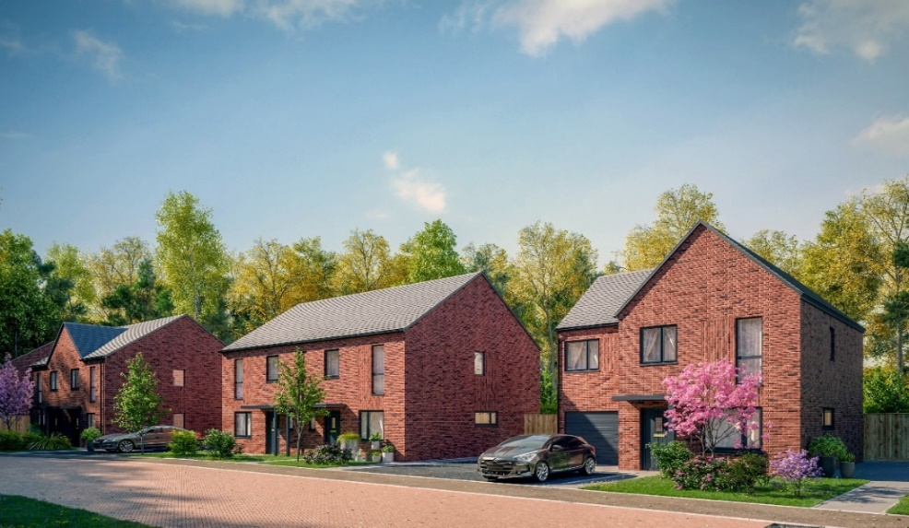
Stronger Communities - Get Building Fund - New College
      Programme
      Demolition & site clearance completed: August 2021
      Planning consent secured: September 2022
      Enabling works: September 2022 – December 2022
      RIBA Stage 4: September 22 – February 2023
      Main Works: March 2023 – Summer 2025

Slide 8
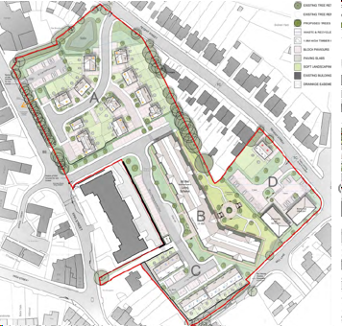

Slide 9
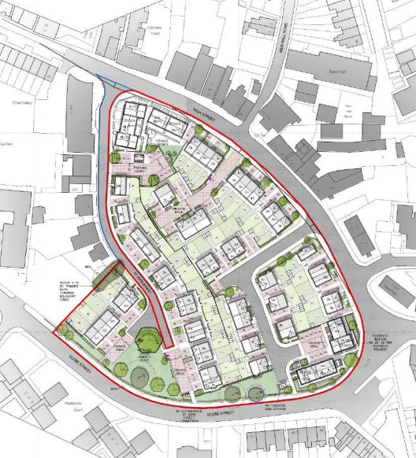
Stronger Communities - Get Building Fund – Glebe Street
      Proposed
      Through detailed design and discussions the Councils delivery partner WHG:
67 WHG affordable dwellings to rent (LEP output requirement of 67 dwellings)
Mix of 57 houses/apartments & 10 bungalows, supporting range of household needs.
All homes NDSS compliant with 28% M4(2).
High standards of design and material to reflect conservation area status.
Scale and massing in keeping with surrounds

Slide 10
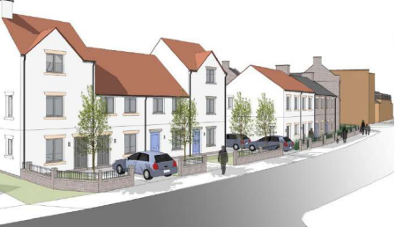
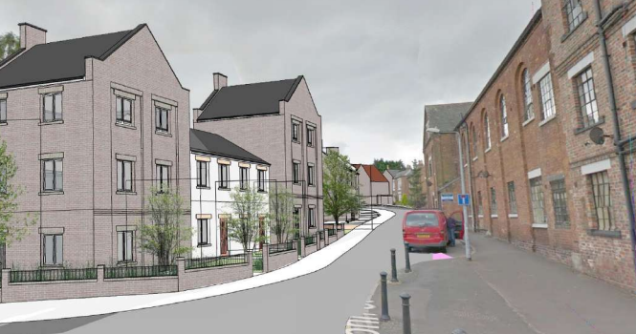
Stronger Communities - Get Building Fund – Glebe Street
Programme
      Planning application: July 2022 for planning committee Dec 2022
      Enabling Works: October 2022 – March 2023
      Main Works: June 2023 – Summer 2025

Slide 11
Financial Pressures
Market volatility impacting on:
Availability of materials causing programme delays and cost increases
Cost uncertainty and volatility of material prices, exacerbated by high energy prices
Risk and contingency levels applied by contractors are far exceeding those anticipated and included in budget estimates
Planning and Building Regulation stipulations and changes:
New Part L – resulting in increased capital cost to achieve stipulated carbon reductions
Adopted planning policy – requirement to incorporate M4(2) and M4(3) dwellings increased size of dwellings

Slide 12
Financial Pressures
Current Cost Plans based on:
End of RIBA Stage 3 design
Feedback from Building Control & LPA on design, policy requirements and S106 contributions including:
  Compliance with and in some cases exceedance of Part L (low carbon)
  Compliance with Part S - provision of EV charging
  Compliance with Nationally Described Space Standards
  Compliance with Homes for All SPD – provision of accessible and adaptable homes.
Detailed elemental cost plans developed by WD and sense checked by Cost Consultants, Gleeds. Detailed cost plans developed by Lovell for WHG proposals at New College / Glebe Street and Jessups for YMCA proposals.
Detailed construction programmes for all residential blocks against which prelim costs have been based
BCIS projection of inflation to mid point of construction

Slide 13
Marches LEP Proposed Outputs
Funding Stream: Stronger Communities
Projects: Granville, New College & Station Quarter

Slide 14
Marches LEP Proposed Outputs
Funding Stream: Stronger Communities – Get Building Fund
Projects: New College & Glebe Street
      *now “community sport facility delivered”

Slide 15
Summary of Recommendations:
• That the board note the progress and updates within the report.
• That the board formally approve the changes in outputs claimed by the LEP with regard to the projects as set out in Report.

